Slide 1
STA130: Midterm Revision

Slide 2
The plan for this session
Your feedback from the mid-semester survey
We decided to move this to the next module to give more revision time today, seeing as one of the pieces of feedback was, that you would like to see more examples.
Midterm assessment information
A spooooooky, statsy, social event for the mentorship program
Revision activity (whole class)
Office hour

Slide 3
What you’ve told us
Thank you to everyone who filled out the survey!

Slide 4
Things you like!
Things you’d like to change
Go faster through quiz question review / go slower through quiz question review
More group work / less group work
Talk about the content from the videos more / less in synch class
More examples, more code demonstrations
Make more explicit links to problems set in class (that said, when we do a demo, it usually IS related to the problem set and provides example code intended to help you with it)
Team Up! activities (selected weeks) and chatting with other students in breakouts (unless everyone is quiet)
Going over challenging quiz questions
Music and notices
Support during office hours and tutorials
Discussion board
Problem sets
Recording synch class
Live code demonstrations
Mix of pre-recorded and live lectures
Reminders and announcements
Module structure
Some advice/recommendations
Sample solutions for Part 1 of the problem sets ARE available!
Tutorial meetings / office hours would currently be the best places to follow up on problem set questions (Parts 1 or 2) if you’re interested in getting clarification.
Slides ARE shared with the weekly videos

Slide 5
Midterm information

Slide 6
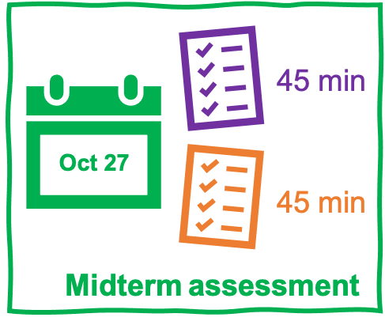
Midterm assessment info: Admin 1
While it is open book, you should still study for it. If you need to check your notes for everything, you WILL run out of time.
The midterm will cover Module 1 to 5 content, inclusive.
There will be a mixture of multiple choice, ‘tick all that apply’ and short written questions.
You won’t have to run code or write large amounts of code, though it is totally fair game to be asked to explain what code does, choose the correct chunk of code to achieve something, or explain what is wrong with some code.
The midterm assessment will consist of two parts. Each part will be a 45-minute timed Quercus assessment. You will have one attempt for each of these parts, and like our weekly quizzes, you cannot pause once you begin.
The midterm assessment will be available from 12:01 a.m. to 11:59 p.m. ET on Wednesday, October 27 (24 hours).

Slide 7
Midterm assessment info: Admin 2
If you are registered with accommodation services and have made arrangements for this assessment, please email sta130@utoronto.ca before you start IF there appear to be any issues with the set up of your assessment.
Each part of the midterm will have about 10–15 questions, we will give you that information when we release the assessments on Wednesday. I.e., you will know how many questions, what they’re each worth and their type before you start each assessment part.
Each part will be worth 25 points (i.e. 50 points total for 90 minutes of assessment).
Please DO NOT use Safari or your tablet/phone to complete the assessment. It will use Quercus quizzes (just like our module quizzes) and so has the same potential issues.
The midterm assessment will be available from 12:01 a.m. to 11:59 p.m. ET on Wednesday, October 27 (24 hours).

Slide 8
Midterm assessment info: Getting help
Prof Caetano and I will be available for ‘tech support’ via email or Zoom during specific ‘tech help’ office hours. You may like to set aside time before/during our support windows to do your midterm assessment.
TECH OFFICE HOURS (on Wednesday, Oct 27):
8:00–9:30 a.m. ET (same Zoom link for all)
2:00–3:00 p.m. ET (same Zoom link for all)
5:00–6:00 p.m. ET (same Zoom link for all)
NO discussion group meetings/drop-in office hours during the assessment window (Oct 27).
There WILL be office hours on Monday, Oct 25 and Tuesday, Oct 26.
Piazza will not be available during the midterm assessment window. Even after Piazza is available, please do not post about the assessments until after the grades are released.
Preparation resources:
See the previous midterms on the Midterm assessment information page.
Try the practice versions of the Modules 1–5 quizzes (on the page above)

Slide 9
Midterm assessment info: notes on answers
If a question asks you to first answer "Yes" or "No" before moving on to the rest of the question, make sure you write yes or no in your answer and then explain as instructed. Follow question instructions carefully.
You don’t have to reference/cite slides and we would not expect that you are using outside sources that you would need to reference either.
Only answers written in English can be marked.

Slide 10
Part A and Part B of the midterm PLUS a Code and analysis PDF will be released at 12:01 a.m. ET on Wednesday. You’ll be able to read over the document with no time limit, but each ‘part’ will be timed, 45 minutes each. You will also be shown you the ‘cover’ of the quiz, the academic integrity questions and reminders of other details.

Slide 11
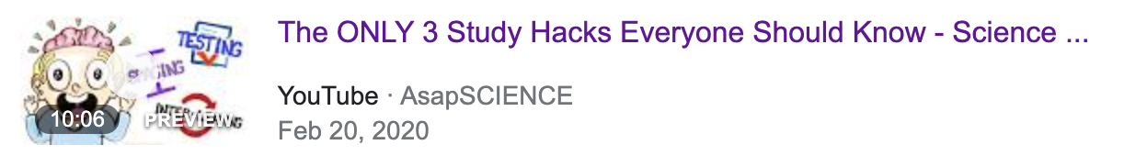
Want some “productive procrastination”?
https://www.youtube.com/watch?v=Y_B6VADhY84

Slide 12
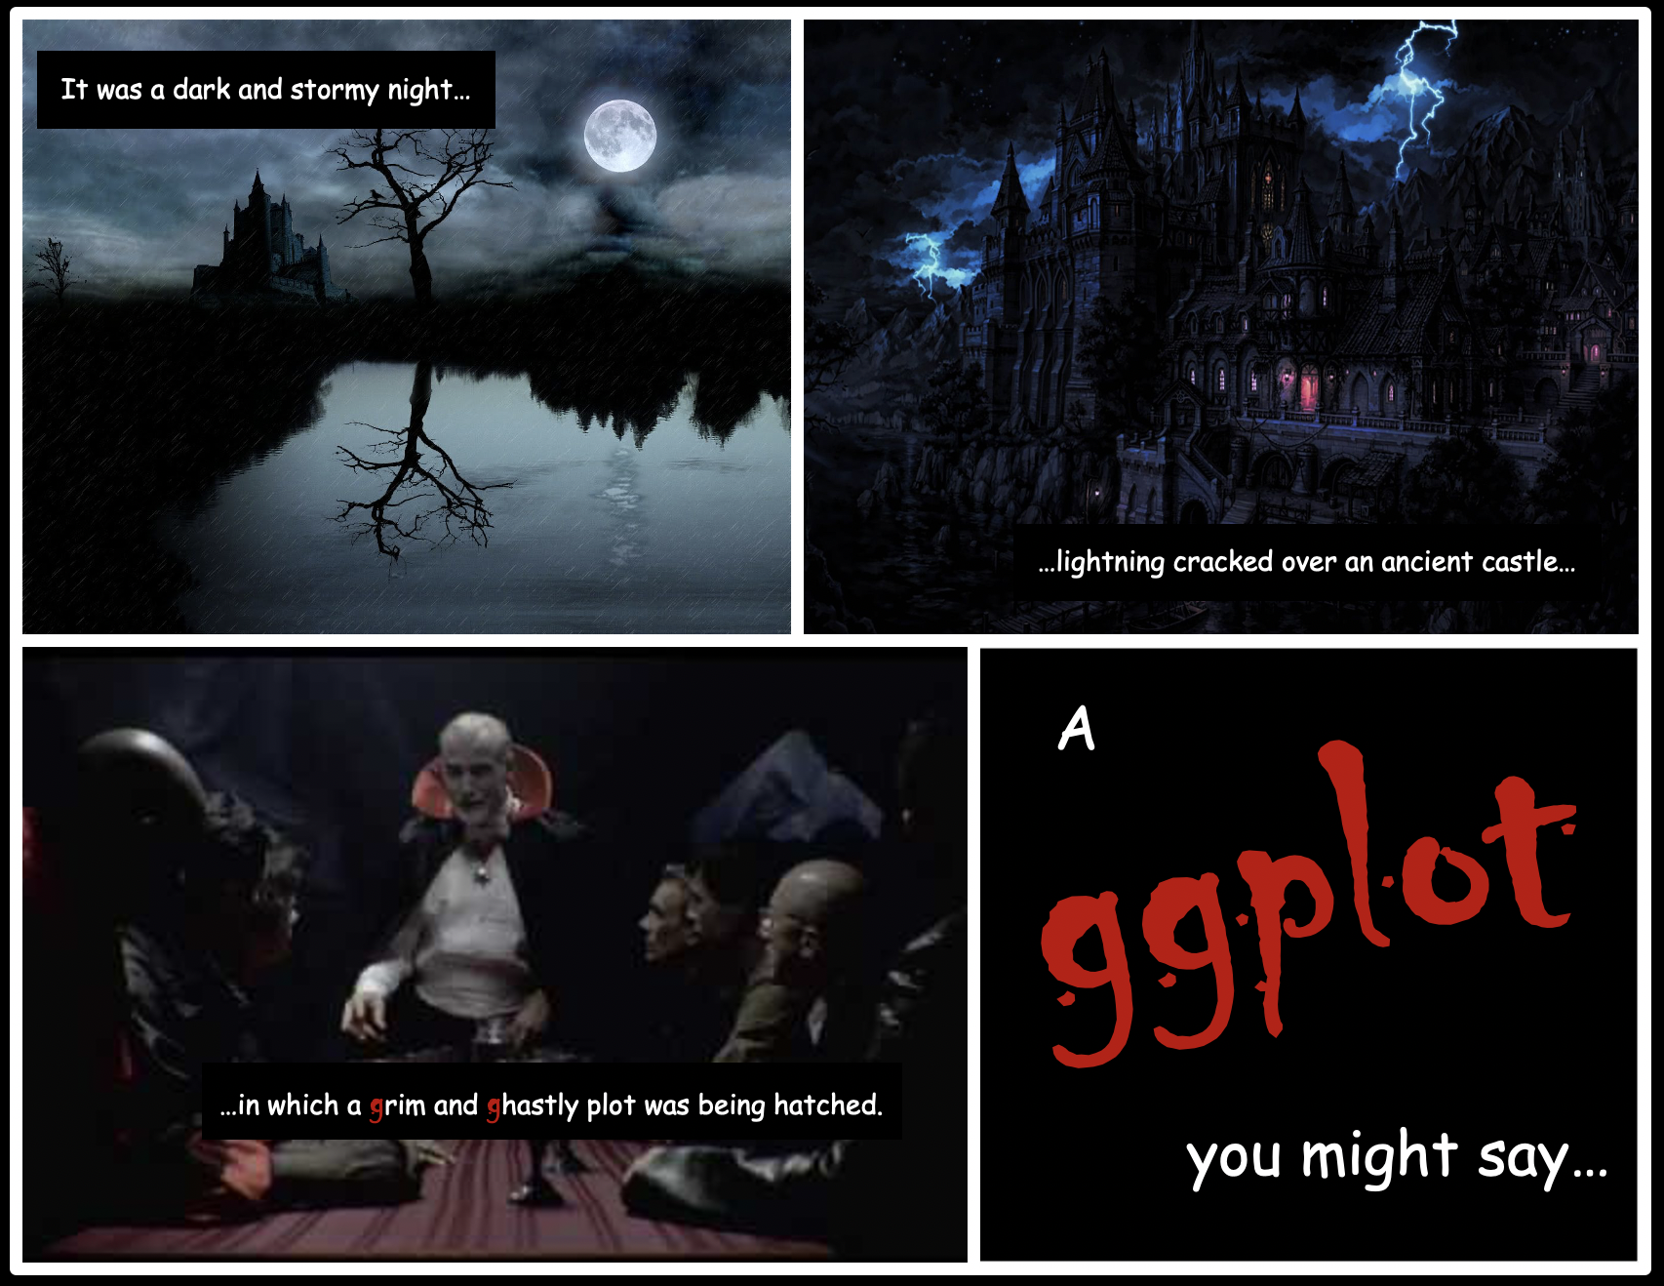
Halloween ggplot workshop! 🎃
Greetings ghouls and goblins! Want to learn how to make compelling data visualizations with the powerful ggplot2 package in R? Want an excuse to dress up for Halloween even if you're not leaving the house? If your answer to one or both of those questions is "YES!" come join us for a very spooky workshop.
When: Friday, October 29 at 3:00 PM - 4:30 PM Your ghost-esses with the most-esses: Nnenna Asidianya, Ananya Jha, and Adele Lauzon
Please register via this link HERE. (Counts toward Personal/Social) A Zoom link will be sent to students registered students on Thursday October 28

Slide 13
Revision

Slide 14
Open the Revision Document on the Quercus Schedule page (or in this Module). (The code is on JupyterHub, but you don’t need it–I’m not demo-ing code today because you won’t be writing code in the midterm.) We’ll be using Zoom polls, BUT I’ve just made a generic one that we’ll reuse. ☺

Slide 15
Answer Key
C
B
B
C
16
14
A
B
B
C (or the 3rd option if you have the old version
B

Slide 16

Extra practice questions (if time)
My partner and I are really enjoying the TV series Foundation (based on Isaac Asimov’s book series).
Without giving away too many spoilers, there is a scene where a character correctly guesses the result of a coin flip 6 times in a row and says “Repeated luck is never luck”. While as a statistician, I’d “never say never”, but I think this is a cool way to demonstrate something about the character, namely that she has some sort of psychic ability.
Assume the coin is fair. Could this have just been luck?

Slide 17
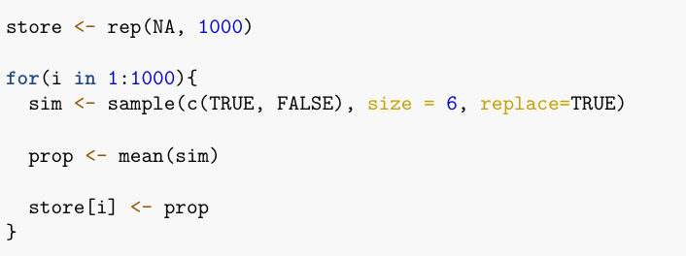
Question 1: What analyses is this?

Slide 18
Question 2: What are then null and alternative hypothesis for this analysis?

Slide 19
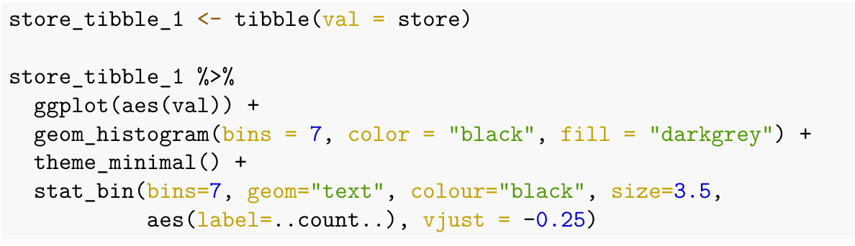
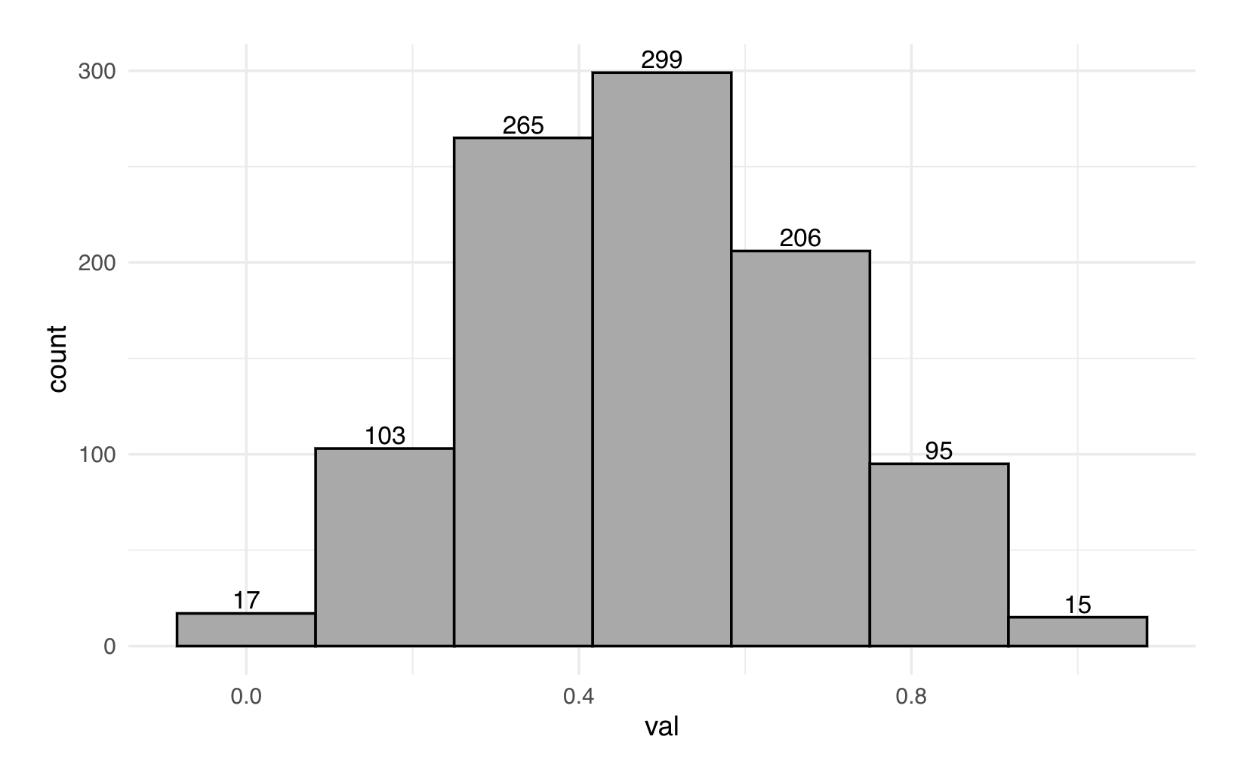
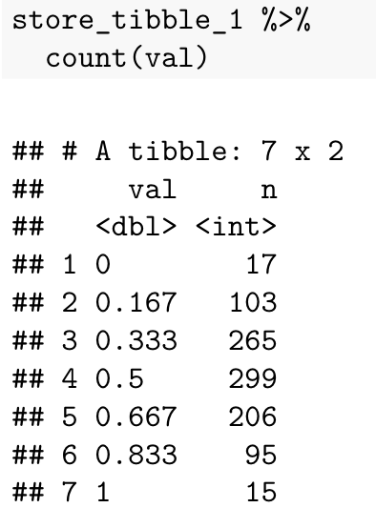
Question 3: Calculate the p-value for this investigation, based on the information below

Slide 20
Extra practice questions continued: NOT the Squid Game
Suppose, for their own amusement, a secretive group of rich people create a series of games with life or death consequences for the players. Further suppose that one of these games involves a bridge of with 18 pairs of glass tiles. One tile of each pair can hold the weight of a person while the other cannot. Suppose, to test out the game concept, that the staff were asked to play a 'non-lethal' version of the game 24 times to get a grip on how many players were likely to survive. They played with 16 starting numbers of players. Assume that once one player made it across, all the players behind that play would also cross safely and there was no sabotaging of other players.

Slide 21
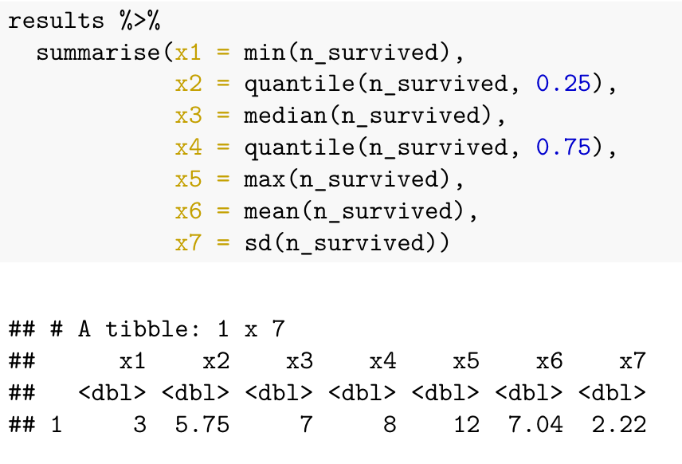
Question 4: What was the minimum, maximum and average number of players that survived, in these tests?

Slide 22
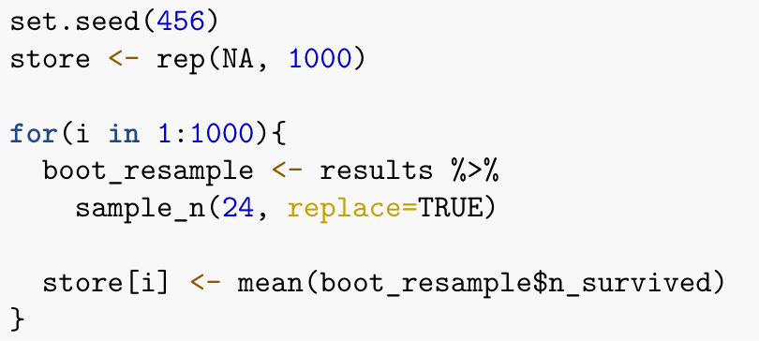
Question 5: What analysis is being conducted in the chunk below?

Slide 23
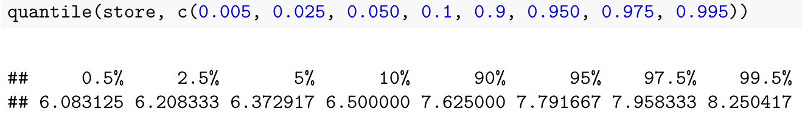
Question 6: Interpret the 95% confidence interval for this investigation.

Slide 24
Question 7:
Suppose someone claimed they thought 9 people would survive on average, when 16 people played (i.e., 56.25%) and you were going to set up a hypothesis test using their claim as your null hypothesis value.
What could you predict about your results for the hypothesis test with a significance cut-off of 5%, before conducting it, based on your 95% confidence interval?

Slide 25
Answer Key (Extra pop culture questions)
Hypothesis test on a single proportion
H₀: p_{correct guesses} = 0.5; H_{A}: p_{correct guesses} ≠ 0.5
(24+22)/1000 = 0.046 (0 correct and 6 are the guess patterns that are like our test stat, or more extreme)
Min = 3, max = 12, average = 7
Bootstrap confidence interval
With 95% confidence, we can claim that when 16 players play this game, without sabotaging each other, the average number that survive is between 6.2 and 8.0.
As 9 is not in our 95% confidence interval we don’t consider it a plausible value for our population parameter. Therefore, we’d expect to find evidence against it being our population parameter value when we conduct a test, so we think the p-value will be significant at the 5% threshold.

Slide 26


To do this week
Study for the midterm by:
Doing the Module 1–5 practice quizzes
Doing the previous midterms under test conditions.
Note: we have covered most of the same things except for scatter plots, so ignore those questions.
Reading through problem set sample solutions (see the Modules tab).
Reach out for help if you’re feeling distressed! There are lots of sources of help. There are ‘healthy’ amounts of stress BUT there are also unhealthy amounts of stress. Your mental health is important!

